Slide 1

Guatemala SQL Server group
November 2018

Slide 2

Christian Araujo @charaujo
Carlos Lopez @CarlosLopezSQL
Eduardo Pivaral @EduardoDBA
Carlos Robles @dbamastery
gtssug.pass.org
Board Members

Slide 3

To celebrate almost two decades of the PASS Summit conference, we will share the inspirational growth of our community through 20 Summits | 20 Stories. These stories reflect the past, present, and future of PASS – both the annual conference and the community-driven organization that makes this event possible.
pass.org/summit/2018/v20.aspx

Slide 4


PASStv at PASS Summit 2018
Can’t attend PASS Summit this year? Tune into PASStv for exclusive access to three full days of Keynote streaming, live sessions, vendor interviews, PASS Board candidate interviews, and more!
https://www.pass.org/summit/2018/PASStv.aspx

Slide 5
Keynotes
Day 1 Keynote - SQL Server and Azure Data Services
Rohan Kumar - Hybrid cloud is the true enabler for digital transformation
Conor Cunningham and Bob Ward - Removing page latch waits in tempdb
Asad and Nellie - Demonstrating Azure Data Studio and Data Clusters, Access multiple data sources through SQL Server
Rohan Kumar - Azure Database Migration Service, Azure SQL Database Hyperscale
Lindsey Allen - Accelerated Database Recovery
Deborah Chen - Multi-Master Replication in CosmosDB
John Macintyre - SQL Data Warehouse competing
Ariel Pisetzky of Taboola - Azure Data Explorer
Patrick LeBlanc - “Self-service for big data” stored in the data lake
Deepsha Menghani - Image classification – databricks lets you build on existing models

Slide 6
Keynotes
PASS Summit 2018 - Day 2 Keynote - Two Decades of Data Innovation
Wendy Pastrick - 185 countries, 300K members in PASS
Raghu Ramakrishnan - The changing landscape of data, Elastic compute and storage Data is exploding, SQL Hyperscale

Slide 7

PASS Membership Survey
Share Your Feedback
As a valued PASS member, we want to hear from you! Complete the PASS Membership Survey for a chance to win $150 USD and help ensure that educational offerings PASS create remain relevant and continue to meet your needs.
Complete Survey at: www.surveymonkey.com/r/PASS2018FEEDBACK

Slide 8
Upcoming Virtual Group Webinars
Virtual Group | Meeting Date | Time | Topic | Website
Women in Technology | 28-Nov-18 | 17:00 – 18:00 (UTC) | Using Azure Databricks, a scalable data soution - Ginger Grant | wit.pass.org
Professional Development | 29-Nov-18 | 17:00 – 18:00 (UTC) | Busy is a Four-Letter Word - Jes Borland | professionaldevelopment.pass.org
DBA Fundamentals | 04-Dec-18 | 17:00 – 18:00 (UTC) | Data Compression 101 - Jess Pomfret | fundamentals.pass.org
Women in Technology | 05-Dec-18 | 17:00 – 18:00 (UTC) | Performance Monitoring Analysis Services Tabular - Shabnam Watson | wit.pass.org
Data Archiecture | 05-Dec-18 | 19:00 – 20:00 (UTC) | SQL Server Temporal Tables - Tim Mitchell | dataarch.pass.org
Global Italian | 12-Dec-18 | 17:00 – 18:00 (UTC) | SQL Server on Linux for high availability - Danilo Dominici | globalitalian.pass.org

Slide 9

Upcoming SQLSaturdays
US/Canada
EMEA
Nov 03 Oregon
Dec 08 Washington, DC
Nov 03 Banja Luka
Nov 24 Tallinn
Nov 24 Parma
Dec 08 Slovenia
Dec 08 Prague
LATAM
APAC
Nov 17 Costa Rica – BI
Nov 24 Rio de Janeiro
Dec 08 Lima
Nov 24 Bangladesh
Visit sqlsaturday.com to register for an event near you!

Slide 10
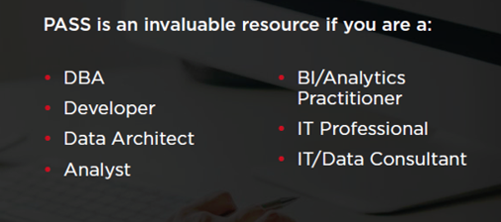
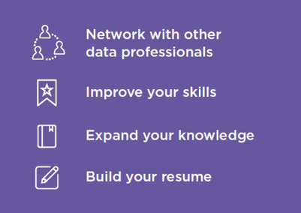

Join PASS to Grow Your Career
Connect with a global network of 250,000+ data professionals
Become a member and gain free access to:
Online educational content
Live webinars
In-person meetups, events, and conferences
Networking, volunteering, and speaking opportunities
The Community
The Benefits
… Join Today!
Notes:
PASS is a global, not-for-profit association where data professionals Connect, Share and Learn.
Joining PASS is free, and gives you access to hundreds of hours of free online content, live virtual and in-person events, the ability to join Local Groups in your area, and an annual conference, PASS Summit.
PASS is a great way to connect with like-minded professionals, increase your technical expertise, and grow your career.

Slide 11

Newsletter
SQL Server 2019 CTP 2.1 released on Nov 06
https://www.microsoft.com/en-us/sql-server/sql-server-2019
Some fixes were made, more info here:
https://docs.microsoft.com/en-us/sql/sql-server/sql-server-ver15-release-notes?view=sqlallproducts-allversions

Slide 12

Newsletter
SQL Server Management Studio 18.0 Preview 5 released on Nov 15
https://docs.microsoft.com/en-us/sql/ssms/download-sql-server-management-studio-ssms?view=sql-server-2017#ssms-180-preview-5
It supports SQL Server 2019 new features
Latest Azure SQL Database and Datawarehouse support
Legacy SSIS support (DTS packages) will be removed on this version
Bug fixes

Slide 13
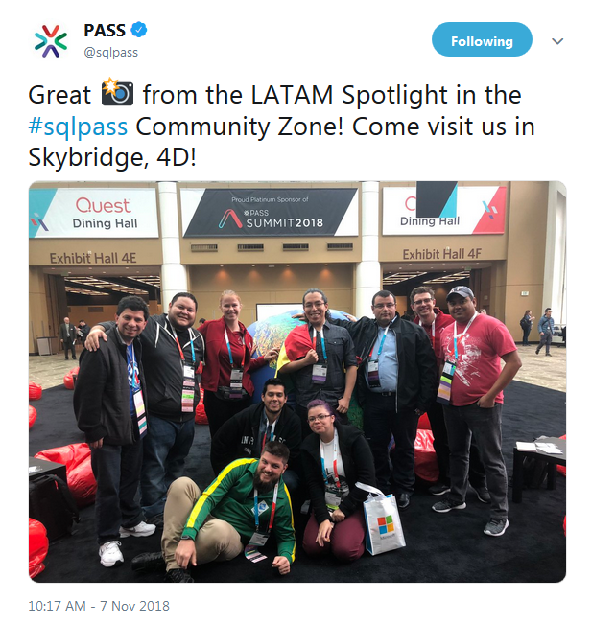
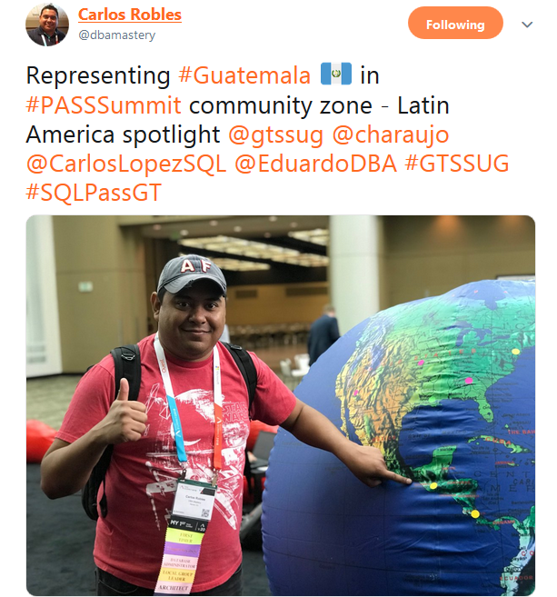

Slide 14
Call for speakers
Want to participate as speaker in Guatemala's SQL Server User Group monthly meeting? then visit:
https://gtssug.pass.org/en-us/sessionsubmission.aspx

Slide 15

Sponsors
Want to become a sponsor? Send an email to: gtssug@gmail.com

Slide 16
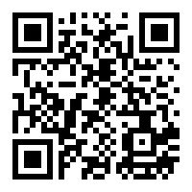
Survey
Just scan the following QR code and help us filling the form:

Slide 17




Follow us
Sign up for a free membership today at:
GTSSUG.PASS.org
#SQLPassGT @gtssug

Slide 18


Connect with PASS
Sign up for a free membership today at:
PASS.org
#sqlpass @sqlpass
@passcommunity

